Slide 1
STUDENT REPOSITORY SYSTEM
RAJASHEKAR KARNATI
174851

Slide 2
CONTENT
Introduction
Existing System
Disadvantages
Proposed System
Advantages
Software Requirements
UML Diagrams
Conclusion

Slide 3
INTRODUCTION
The main objective of this Repository system application is to store all the details of the students permanently by using the one-time registration process.
The students can register their details at once and they get one unique id which is useful to fetch their details to any application automatically.

Slide 4
EXISTING SYSTEM
In the existing repository system, the students have to enter their details every time whenever they required for filling the application.
Student don’t have any Unique ID in Existing system. So Even Searching for Particular Student be a tedious task.

Slide 5
DISADVANTAGES
In Existing System, Student has to fill all personal details everytime he want to apply for a Job Application. It is a Timeconsuming process.
Even Sometimes there may be a misplacement of data

Slide 6
PROPOSED SYSTEM
In the proposed repository system the students no need to enter their details every time.
By using their unique registration id the details are automatically fetched to the application only extra details required are to be entered.
The students can update their details in the existed profile whenever they required.
It is the user-friendly environment and less time-consuming.

Slide 7
ADVANTAGES
The Details of Student will auto-populate in fields which are required while applying any job through Student Unique Id.
There will be no misplacement of Student Details

Slide 8
SOFTWARE REQUIREMENTS
Operating System : Windows
Database : SQL Server 2014
IDE :Visual Studio 2019
Platform : .Net
Web server : IIS
Front End : Javascript, CSS, Html, Bootstrap

Slide 9
FLOWCHART
Start
Admin
Student
Jobs
Login
Register
Login
Apply Jobs
Input correct
No
No
Input correct
Fill the form Information
Yes
Input correct
Yes
Yes
No
Add Photo
Update Details
Applied Jobs
Change Pwd
Add New Job
Manage Users
Manage Jobs
End
Logout
Maintain all the data in database

Slide 10
USECASE DIAGRAM
Register
Login
Login
Add Jobs
Add Photo
Manage Students
Update Details
Admin
Manage Jobs
Student
Applied jobs
Logout
Logout

Slide 11
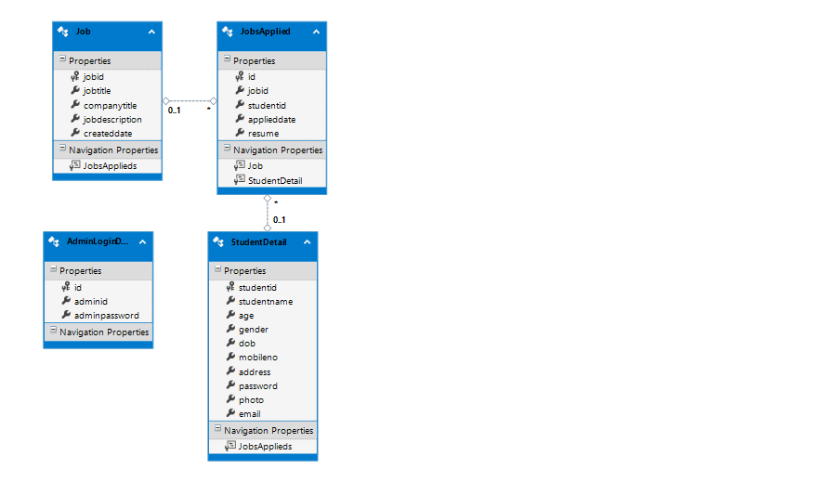
CLASS DIAGRAM

Slide 12
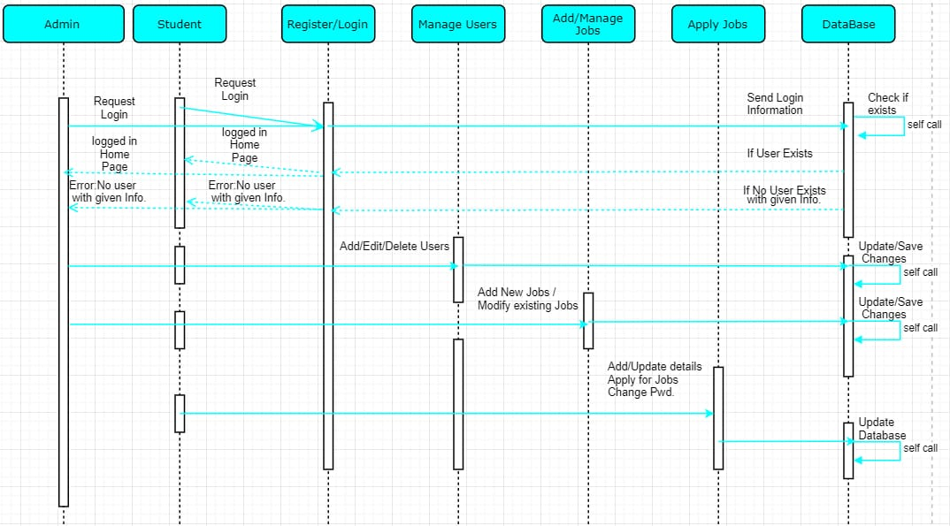
SEQUENCE DIAGRAM

Slide 13
ER DIAGRAM
Student Id
Student Name
Email
Username
Password
Address
Admin
Edit or Delete
Student
Mobile No
Add, Edit or Delete
Apply Job
Job Id
View
Jobs Applied
Jobs
Has
Uploaded Date
Job Role
Job Id
Student Id
Applied Date
Job description

Slide 14
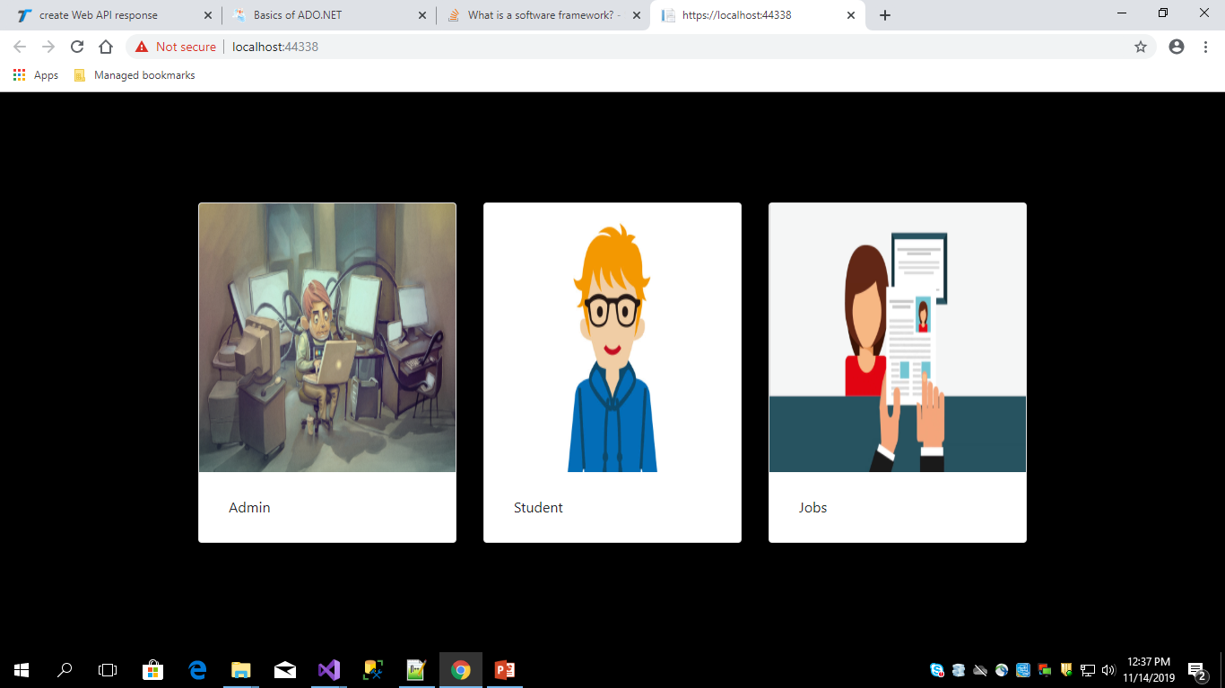
SCREENSHOTS

Slide 15
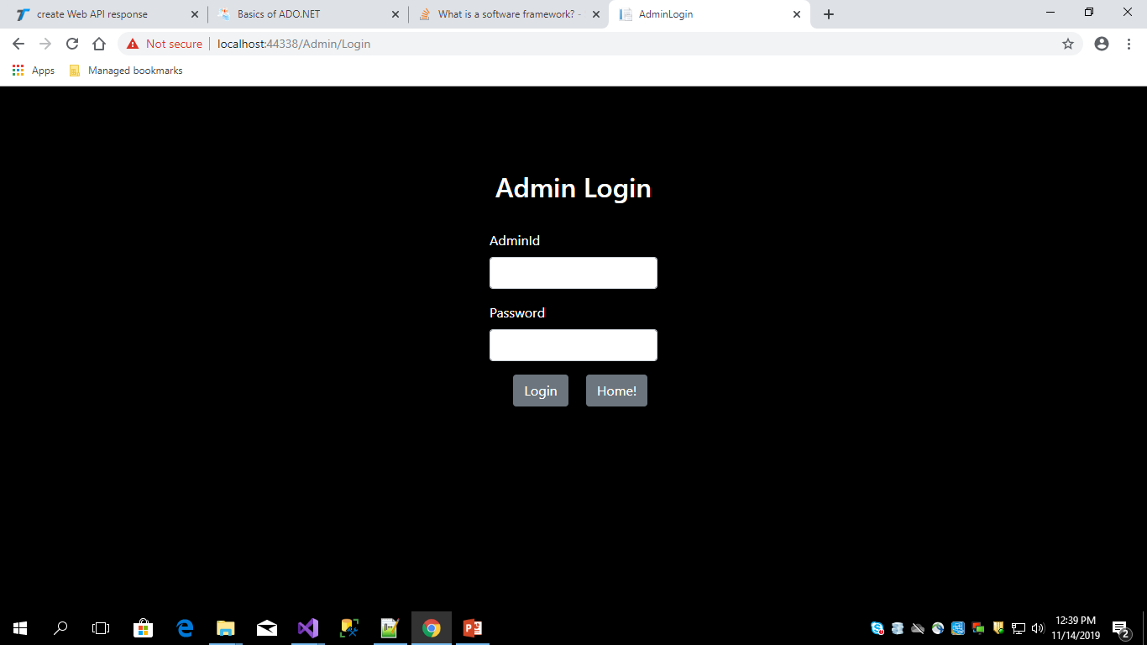

Slide 16
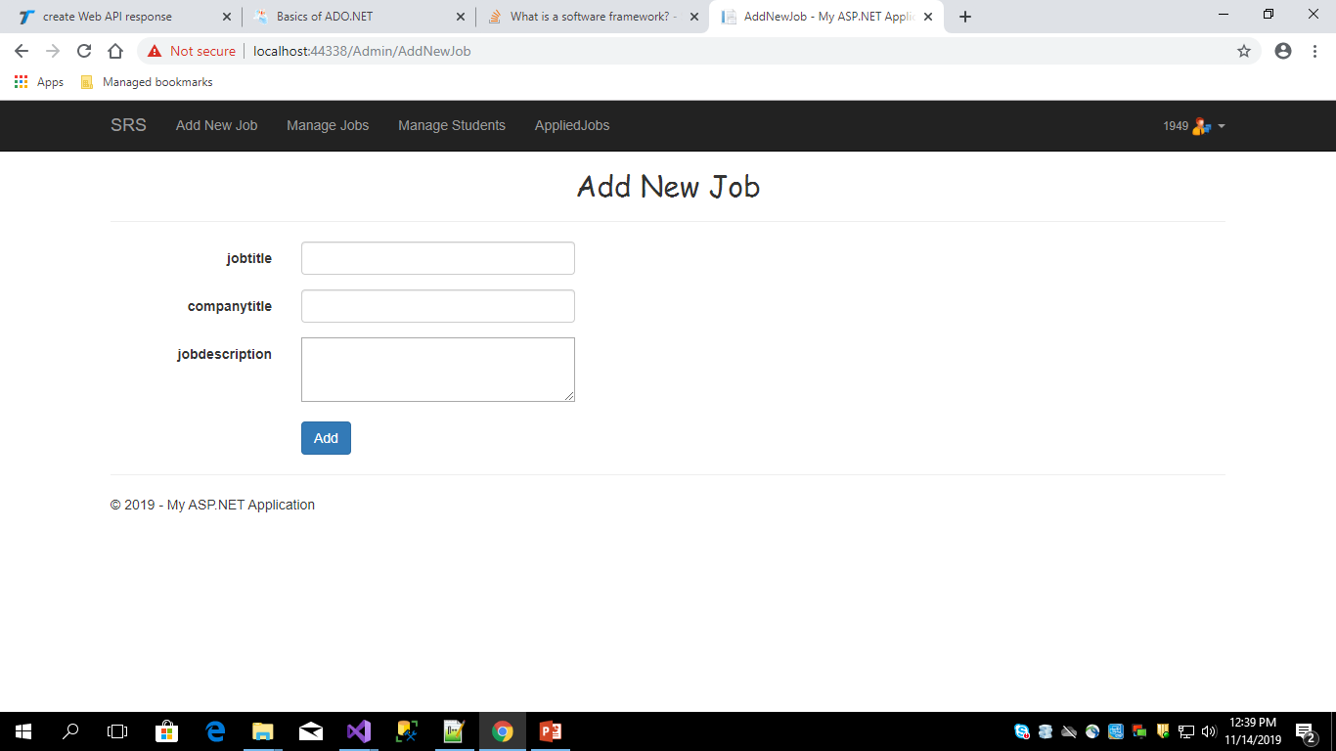

Slide 17
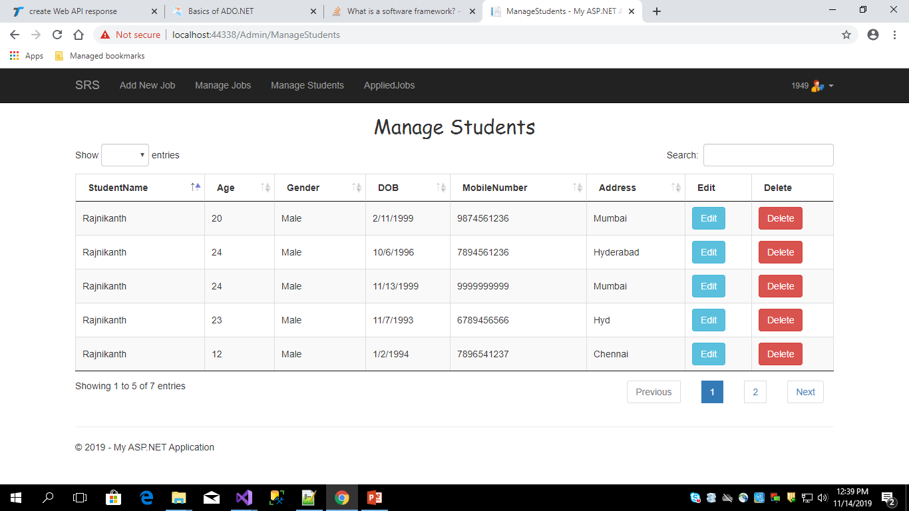

Slide 18
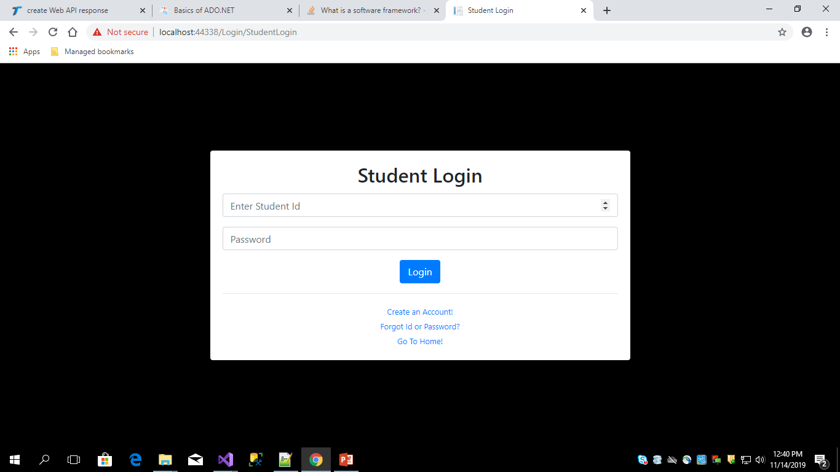

Slide 19
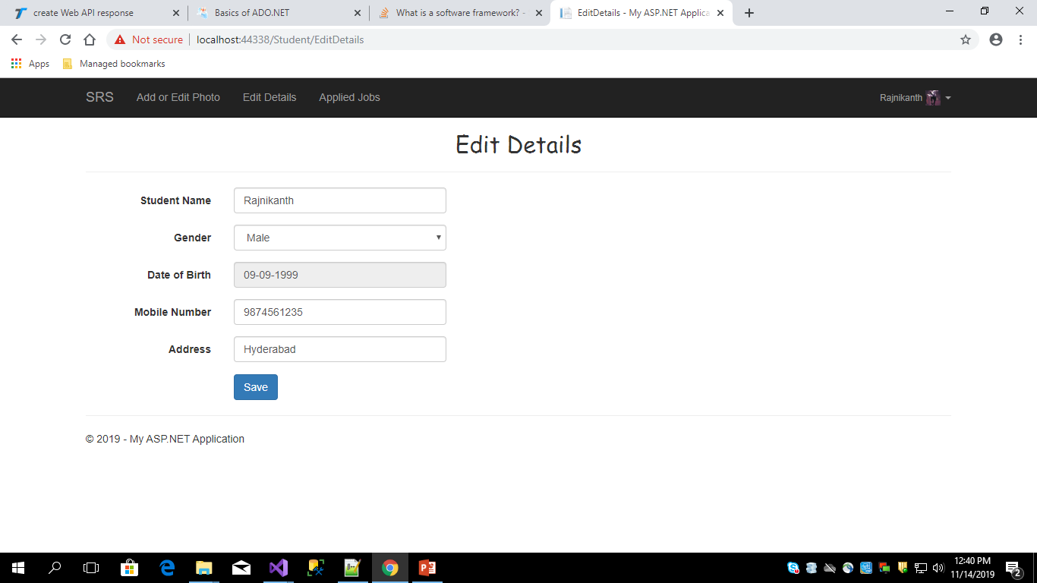

Slide 20
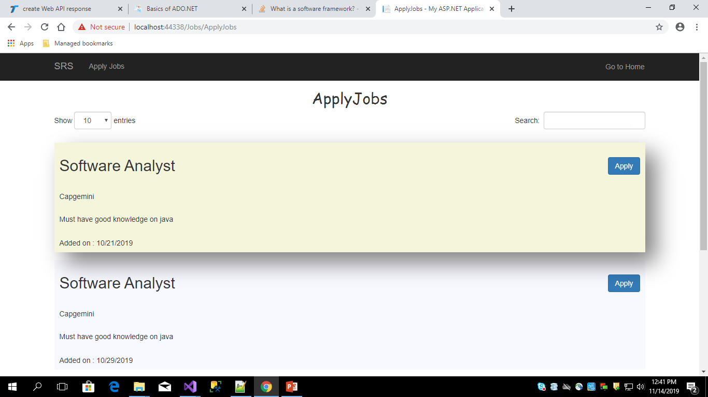

Slide 21
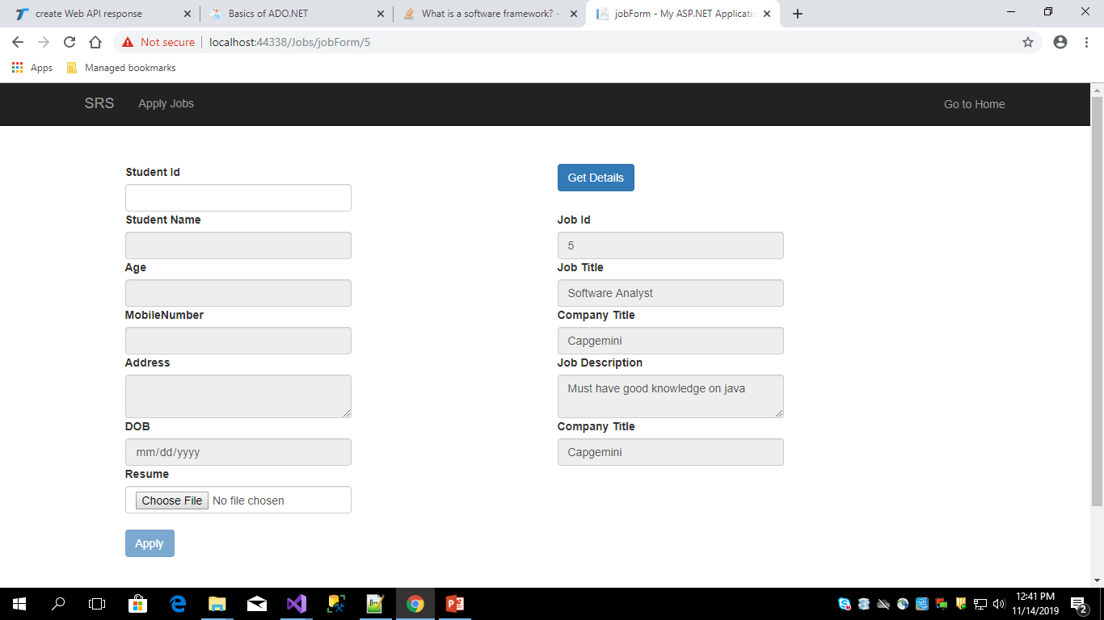

Slide 22
CONCLUSION
The project aim to develop a student repository system. In order to provide a solution to current problems and increase the efficiency. Thus our system meets very basic and necessary needs of a students.

Slide 23
THANK
YOU……..

